Slide 1
COMP60009 – Emerging Technologies 1 – Lecture 7
VIJU PRAKASH
Senior Lecturer,
Department of Computer Science,
BUV, Hanoi.

Slide 2

SPLUNK - INTRODUCTION
We can monitor servers, applications, logs, and networks.
It is widely used as a log monitoring tool.
Ex: an e-commerce website.
Unfortunately, it is not an open-source product.
In the free trial, it is possible to store only log files that are less than or equal to 500 MB/one day.
In real-time, it is possible to store log files equal to 100 GB/one day.

Slide 3
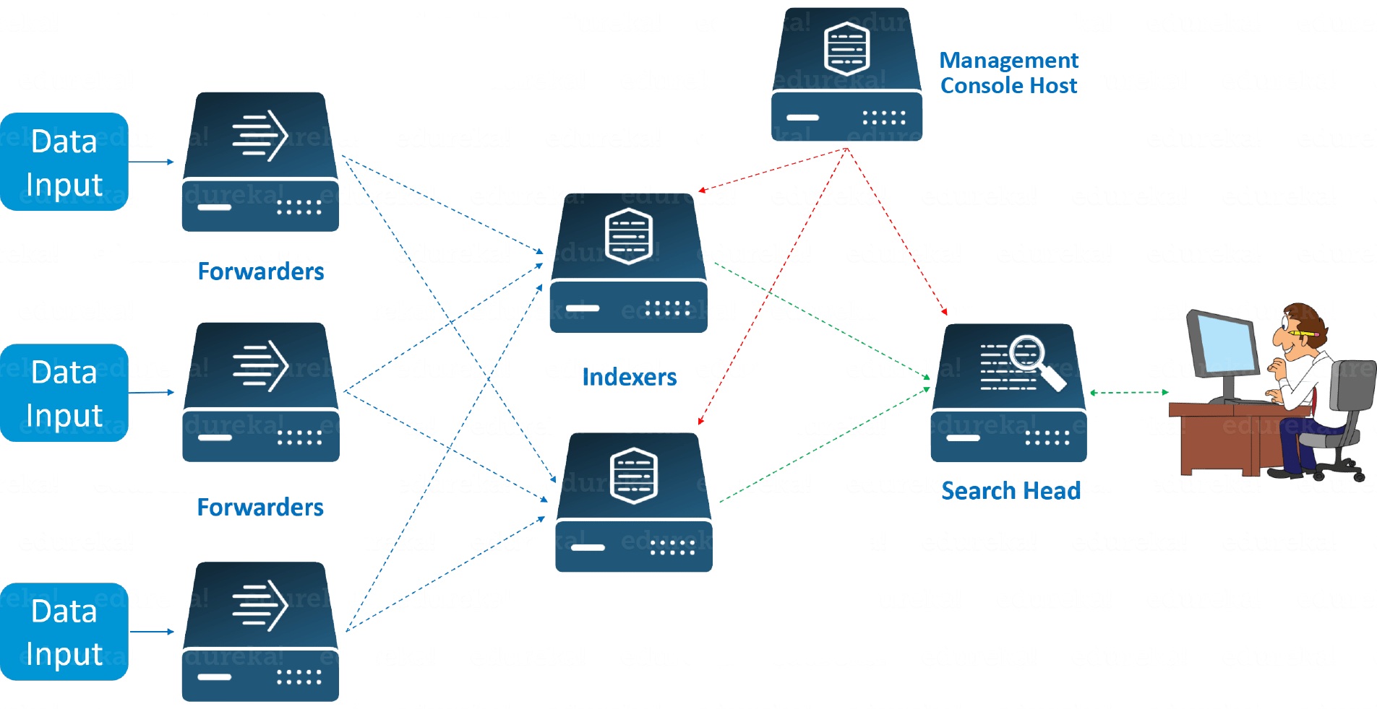
SPLUNK - COMPONENTS
Search head
Indexers
Forwarders

Slide 4
SPLUNK – HOW TO INSTALL IT?
Create a free account at: www.splunk.com
AMI: Ubuntu
Storage: 30 GB (8 GB isn’t sufficient)
Minimum number of instances: 2
Security group: Openall

Slide 5

SPLUNK – HOW TO INSTALL IT?

Slide 6
SPLUNK – HOW TO INSTALL IT?
sudo su
cd /opt
wget -O splunk-9.1.1-64e843ea36b1-Linux-x86_64.tgz “https://download.splunk.com/products/splunk/releases/9.1.1/linux/splunk-9.1.1-64e843ea36b1-Linux-x86_64.tgz”
Now extract the compressed file. (Use tar –xvzf command)
cd splunk

Slide 7
SPLUNK – HOW TO INSTALL IT?
cd bin
./splunk start
Enter your username and password.
Now you can see there that Splunk is running on port number 8000
So, copy the public IPv4 of the EC2 instance and paste it to a browser.
Now Splunk will prompt your credentials. Input them. You would have now entered into the dashboard of Splunk.

Slide 8
SPLUNK – HOW TO INSTALL IT?
Launch your slave machine.
sudo su
cd /opt
wget -O splunkforwarder-9.1.1-64e843ea36b1-Linux-x86_64.tgz "https://download.splunk.com/products/universalforwarder/releases/9.1.1/linux/splunkforwarder-9.1.1-64e843ea36b1-Linux-x86_64.tgz"
Extract and move into the extracted folder.
cd bin

Slide 9
SPLUNK – HOW TO INSTALL IT?
./splunk start
Provide your username and password.
Now you have successfully configured the Splunk forwarder in a slave machine.
Now we should enable a common port number between a master and a slave.

Slide 10
SPLUNK – HOW TO INSTALL IT?
Go to your master EC2 instance. Ensure that you are in bin folder.
./splunk enable listen 9997
Provide your username and password.
Now your server is listening to the port 9997.
You should go to the slave EC2-instance and provide the following command.
./splunk add forward-server <Master_IPv4>:9997
Provide username and password.

Slide 11
SPLUNK – HOW TO INSTALL IT?
Now to forward specific log files, execute the following command on a slave machine.
./splunk add monitor /var/log/syslog –index main
Now go to your master EC2-instance and monitor the log files.

